Slide 1
“Teach A Level Maths”
Statistics 1
The Binomial Distribution
© Christine Crisp

Slide 2
Statistics 1
AQA
MEI/OCR
OCR
"Certain images and/or photos on this presentation are the copyrighted property of JupiterImages and are being used with permission under license. These images and/or photos may not be copied or downloaded without permission from JupiterImages"

Slide 3
Find the following

Slide 4
In Statistics we often talk about trials.
We mean an experiment, an investigation or the selection of a sample.
e.g. We roll a die.
There are 6 possible results ( outcomes ): 1, 2, 3, 4, 5 or 6.
However, if we are interested in getting a 6, we could say the trial has only 2 outcomes: a 6 or not a 6.
Lots of trials can be thought of as having 2 outcomes.
e.g. A seed is sown and the flower is either yellow or not yellow.
e.g. A computer chip is taken off a production line and it either works or it doesn’t.

Slide 5
The 2 possible outcomes of these trials are called success and failure. We will label the probability of success as p and failure as q.
What can you say about p + q ?
ANS: p + q = 1 since no other outcomes are possible.
Suppose that we repeat a trial several times and the probability of success doesn’t change from one trial to the next.
Suppose also that each result has no effect on the result of the other trials.
The trials are independent.
With these conditions all satisfied, we can use the binomial model to estimate the probability of success and to estimate the mean and variance.

Slide 6

SUMMARY
The Binomial distribution can be used to model a situation if all of the following conditions are met:
A trial has 2 possible outcomes, success and failure.
The trial is repeated n times.
The probability of success in one trial is p and p is constant for all the trials.
The trials are independent.
n and p are called the parameters of the distribution.

Slide 7
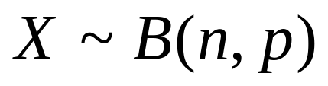
e.g. We roll a fair die 4 times and we count the number of sixes.
Does this situation fit with the Binomial Distribution described?

Slide 8
Are they definitely, definitely not (why not) or maybe (why) binomial distributions?
X is the number of heads when a coin is tossed 20 times.
A particular test has a pass rate of 60%. X is the number of students who fail the test out of a class of 30.
A fair cubical dice is rolled until a 6 occurs. X is the number of times I get a 4.
A jar contains 49 balls numbered 1 to 49. Six of the balls are selected at random. X is the number of times that four of the balls have even scores.
X is the number of sixes when a die is thrown 10 times.

Slide 9
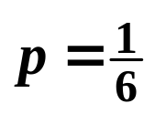
e.g. We roll a fair die 4 times and we count the number of sixes.
There are 4 trials
There are 2 outcomes to each trial. ( Success is getting a 6 and failure is not getting a 6 ).
There is a constant probability of success ( getting a 6 ), so for every trial.
The trials are independent.
This experiment satisfies the conditions for the binomial model.

Slide 10
Setting up a Binomial Distribution
A probability distribution gives the probabilities for all possible values of a variable.
We are now going to find these probabilities using an example. It’s a bit complicated but will result in a formula which is in your formula book and is very easy to use.
Consider the experiment of rolling the die 5 times.
Suppose we start with finding the probability of getting 3 sixes.

Slide 11
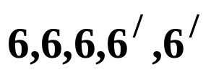



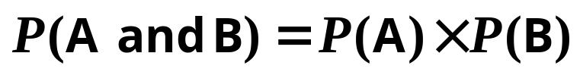
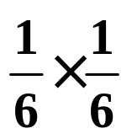
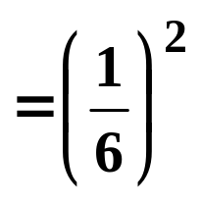


We need to do 2 things:
find the probability of getting ( in that order ) where is “not a six” and
find the number of ways of getting 3 sixes ( in any order ).
We know the probability of getting a 6 if we roll the die once is given by
If we roll the die again the outcome is independent of the 1st outcome, so we can use the formula
if A and B are independent
giving

Slide 12
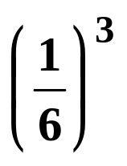

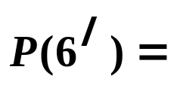
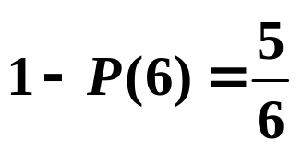
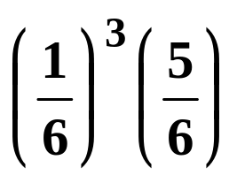
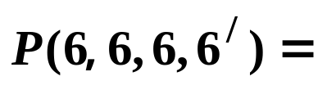
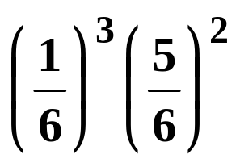
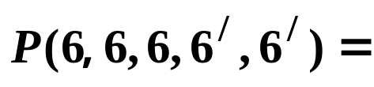
Similarly,
Now we have the probability of 3 sixes, we want the last 2 rolls to give anything except a six.
The probability of not getting a six is given by:
So,
And finally,

Slide 13
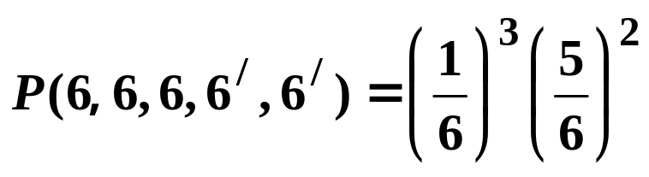
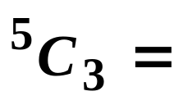

So,
Now we need
the number of ways of getting 3 sixes.
6 6 6 6/ 6/
6 6 6/ 6 6/
6 6 6/ 6/ 6
6 6/ 6 6 6/
6 6/ 6 6/ 6
6 6/ 6/ 6 6
6/ 6 6 6 6/
6/ 6 6 6/ 6
6/ 6 6/ 6 6
6/ 6/ 6 6 6
Fortunately we don’t have to do this all the time!
If we think of it as choosing the 3 positions for the sixes we realise that we have

Slide 14
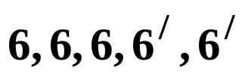
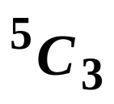
We now have
the probability of getting ( in that order ) is
the number of ways of getting 3 sixes is
So the probability of 3 sixes ( in any order ) is

Slide 15
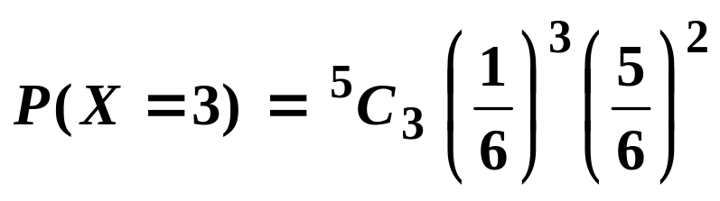
If X is the random variable “ the number of sixes when a die is rolled 5 times ” then X has a binomial distribution and
Tip: For any binomial probability, these numbers . . .
are equal

Slide 16
If X is the random variable “ the number of sixes when a die is rolled 5 times ” then X has a binomial distribution and
and this . . .
is the sum of these

Slide 17

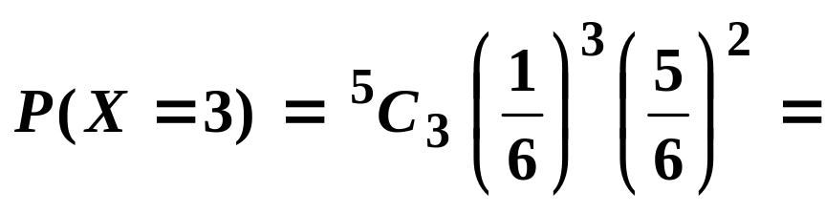

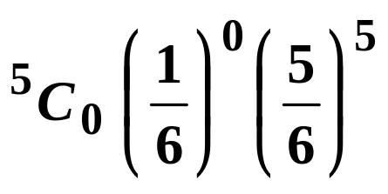


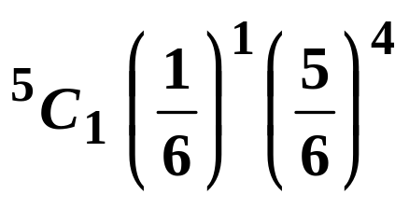

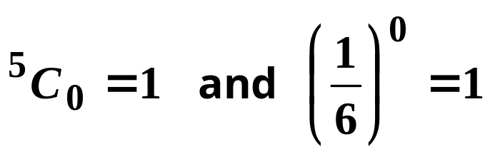
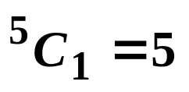
We can simplify the expression using a calculator:
( 4 d.p. )
We can find the probabilities of getting 0, 1, 2, 4 and 5 sixes in the same way.
Tip: It saves some fiddling on the calculator if you remember that
It’s useful to remember that
Can you find the probabilities that X = 0 and X = 4 and X = 5 ?
( Give the answers correct to 4 d.p. )

Slide 18
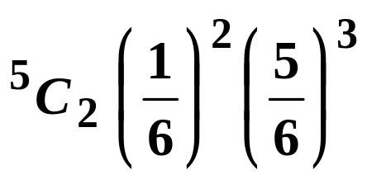


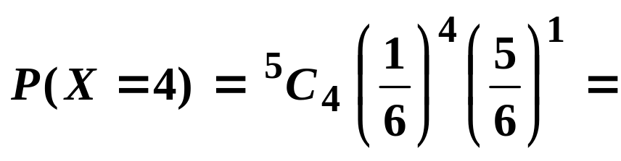


The probabilities are:
Tip: If you have answers listed like this you need not write them out in a table.
Since the sum of the probabilities is 1, I added the others and subtracted from 1.
The probability isn’t exactly zero so we need to show the 4 noughts to give the answer correct to 4 d.p.

Slide 19
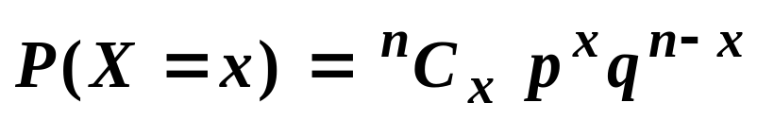
In general, if X is a random variable with a binomial distribution, then we write
where n is the number of trials and
p is the probability of success in one trial.
The probabilities of 0, 1, 2, 3, . . . n successes are given by
where x = 0, 1, 2, 3, . . . n and q = 1 − p
There are slightly different ways of writing this formula so check your formula book to see how it is written there.
( The Binomial distribution is just a special case of a discrete probability distribution )

Slide 20


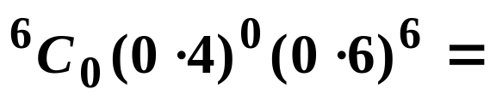


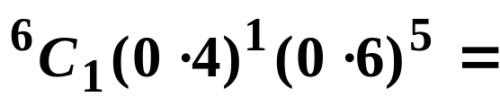





e.g.1 If find the probability that X equals 0 or 1 giving the answer correct to 3 d.p.
In order to find this probability we have to add 2 results.
To be sure of the accuracy of the answer, we must use 4 decimal places in the individual calculations.
Solution:
When adding numbers, always use 1 more d.p. than you need in the answer OR store each individual number in your calculator’s memories.
If we had used 3 d.p. for the individual probabilities we would have got for the answer, which is incorrect.

Slide 21
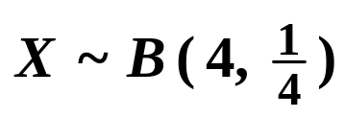



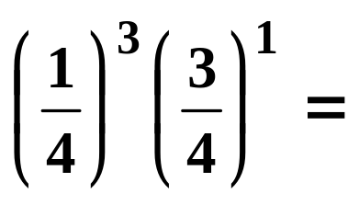

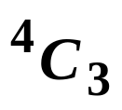




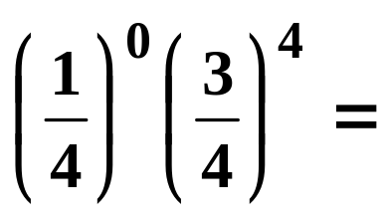
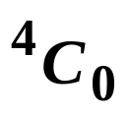


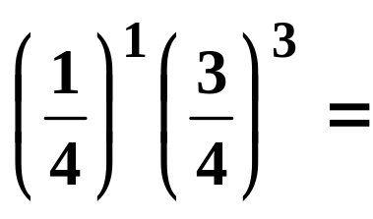

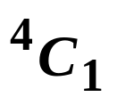




e.g.2 If , find
(a)
(b)
(c)
Solution:
(a)
Don’t forget that the binomial always has X = 0 as one possibility.
(b)
< 2
= 0 or 1

Slide 22





e.g.2 If , find
(a)
(b)
(c)
Solution:
c)
Can you see the quick way of doing this?
We found this in part (b)
ANS: Subtract the probabilities that we don’t want from 1.
Tip: When you are finding probabilites for an inequality such as it’s helpful to jot down the values you want. If there are more than a couple, you should probably be subtracting the ones you don’t want from 1.

Slide 23





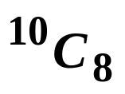
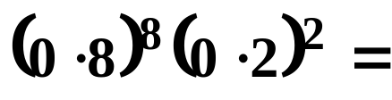




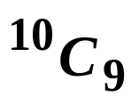
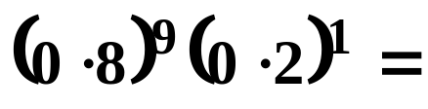



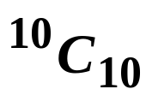
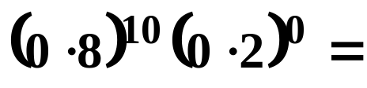





Exercise
1. If find
(a)
(b)
(c)
Solution:
(a)
(b)
(c)

Slide 24


Slide 25
The following slides contain repeats of information on earlier slides, shown without colour, so that they can be printed and photocopied.
For most purposes the slides can be printed as “Handouts” with up to 6 slides per sheet.

Slide 26
In Statistics we often talk about trials.
We mean an experiment, an investigation or the selection of a sample.
e.g. We roll a die.
There are 6 possible results ( outcomes ): 1, 2, 3, 4, 5 or 6.
However, if we are interested in getting a 6, we could say the trial has only 2 outcomes: a 6 or not a 6.
Lots of trials can be thought of as having 2 outcomes.
e.g. A seed is sown and the flower is either yellow or not yellow.
e.g. A computer chip is taken off a production line and it either works or it doesn’t.

Slide 27
The 2 possible outcomes of these trials are called success and failure. We will label the probability of success as p and failure as q.
p + q = 1 since no other outcomes are possible.
Suppose that we repeat a trial several times and the probability of success doesn’t change from one trial to the next.
Suppose also that each result has no effect on the result of the other trials.
The trials are independent.
With these conditions all satisfied, we can use the binomial model to estimate the probability of successes and the mean and variance.

Slide 28
e.g. We roll a fair die 4 times and we count the number of sixes.
There are 4 trials
There are 2 outcomes to each trial. ( Success is getting a 6 and failure is not getting a 6 ).
There is a constant probability of success ( getting a 6 ), so for every trial.
The trials are independent.
This experiment satisfies the conditions for the binomial model.

Slide 29

In general, if X is a random variable with a binomial distribution, then we write
where n is the number of trials and
p is the probability of success in one trial.
n and p are called the parameters of the distribution.
The probabilities of 0, 1, 2, 3, . . . n successes are given by
where x = 0, 1, 2, 3, . . . n and q = 1 − p
There are slightly different ways of writing this formula so check your formula book to see how it is written there.

Slide 30

e.g.1 If find the probability that X equals 0 or 1 giving the answer correct to 3 d.p..
In order to find this probability we have to add 2 results.
To be sure of the accuracy of the answer, we must use 4 decimal places in the individual calculations.
Solution:
If we had used 3 d.p. for the individual probabilities we would have got for the answer, which is incorrect.

